Slide 1
Sex-specific and lineage-specific alternative splicing in primates
Blekhman et al, 2010 - Genome Research
RNA Seekers
Beatriz Mizoguchi
Elizabeth Chatt
Jie Luo
Xinyu Fu
Notes:
D

Slide 2
OUTLINE
Background
Paper workflow (Methods)
Our approach
Results Comparison
Conclusions
Notes:
D

Slide 3
Paper BACKGROUND
Background
RNA-seq of liver tissues
Human, chimpanzee, and rhesus macaque
Male and female
Gene Identification Goals
Expression levels which evolve under natural selection
Sexually dimorphic expression patterns
Variation in exon usage and alternative splicing
Workflow
Our Approach
Results comparison
Conclusion
Notes:
D
Previous studies of variation in exon usage were conducted with microarrays limited to highly sequenced genomes, limited to small number of transcripts
Little known about variation in exon usage and alternative splicing within or between species

Slide 4
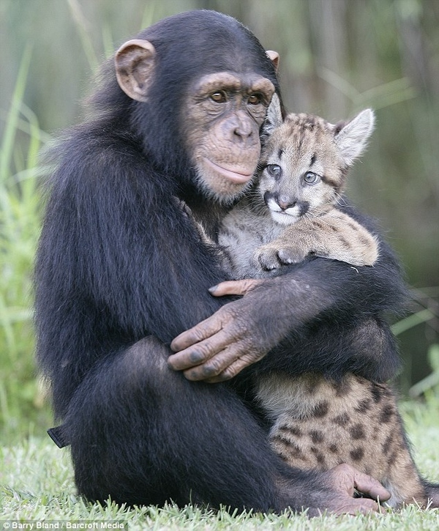
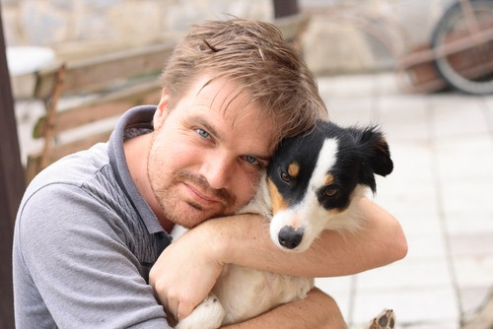
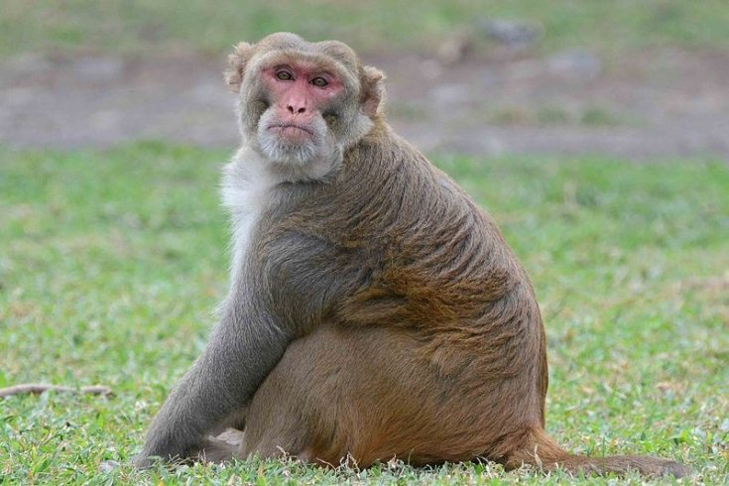
Some of their conclusions:
Genes controlling lipid metabolism was more different between sexes than between species
More differences between rhesus monkeys and humans or chimps, than differences between humans and chimps in terms of gene expression
Background
Workflow
Our Approach
Results comparison
Conclusion
Notes:
D

Slide 5
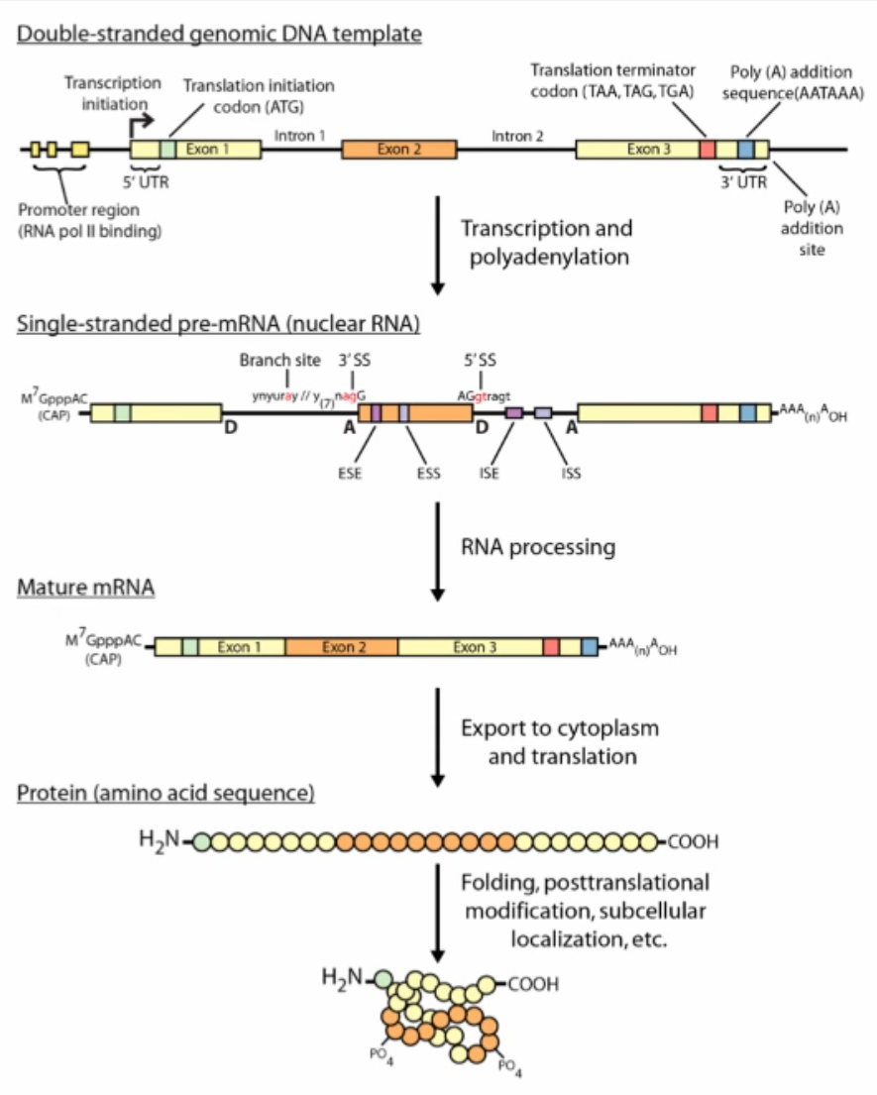
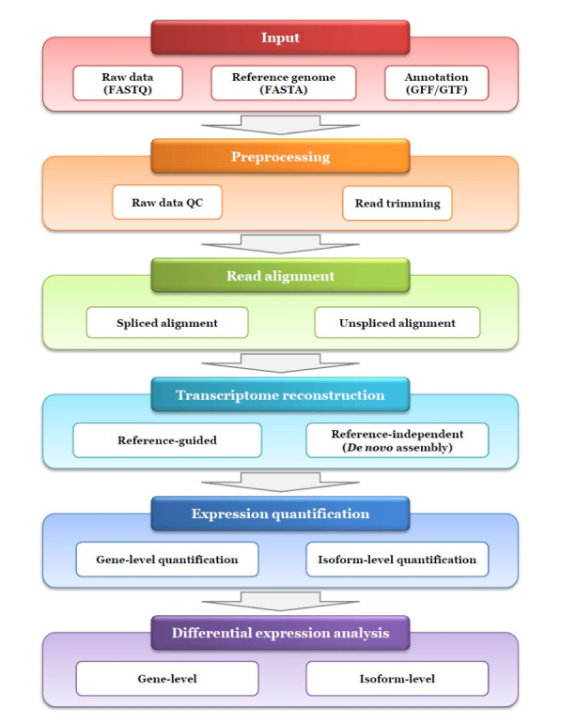
Background: mRNA processing and RNA-seq
Background
Workflow
Our Approach
Results comparison
Conclusion
Seok Yang and Sangwoo Kim, 2015.
https://www.ncbi.nlm.nih.gov/pmc/articles/PMC4742321/

Slide 6
RNA-Seq
Common analysis goals of RNA-seq:
Gene expression and differential expression
Alternative expression analysis
Transcripts discovery and annotation
Allele specific expression (SNPs)
Mutation discovery
Fusion detection
Notes:
So quick review of important concepts.
We have a promoter region, where RNA pol II binds, and transcribes continuously, through the introns, exons, pass the 3' untranslated region, and continues for a bit before falling off
Now the pre-mRNA gets processed, a necessary step is where the splicesome cuts out the introns, the intervening sequences. It gets instructions from the features in the introns that tell it where the intron stops and the next exon starts, and this is the idea behind alternative splicing.
Then to become a mature mRNA, the 5' cap on methionine is added, and poly A tail is retained.
So it is this mature mRNA that the RNA sequencing is indirectly trying to measure the abundance of. The instrumentation that we use today actually sequence this mature mRNA converted into cDNA, and we are not even sequencing the entire cDNA, just fragments of it, for example, the sequencing results or the reads from the files that the authors had was 35 bases long, sequenced from one side, which makes it single-end read.
Common analysis goals of RNA-seq: what people usually use it for:
Gene expression and differential expression
Alternative expression analysis
Transcripts discovery and annotation
Allele specific expression (SNPs)
Mutation discovery
Fusion detection
Since RNA seq is an unbiased technique and so doesn’t require predesigned probes, and therefore doesn’t require prior knowledge of all possile exon boundaries as well as exon-exon junction, this makes it well suited to study alternative expression.
And as you can see RNA seq is used in many different study designs, and this makes it difficult to do a comprehensive analysis of RNA seq, since tools developed are geared towards each of these specific goals in mind.
Since our authors wanted to check differential expression between species and alternative expression analysis, they decided to use a specific work flow and that is what we tried to follow.

Slide 7
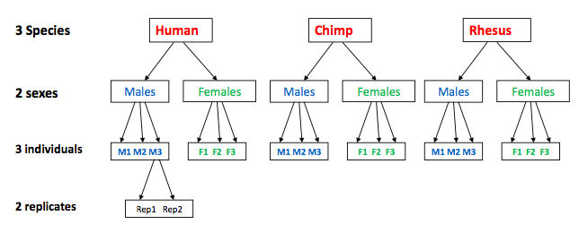
METHODS
Background
Sample collection/RNA Extraction
Workflow
Our Approach
Results comparison
RNA-Seq = Illumina
Conclusion
Read mapping
Notes:
B

Slide 8
METHODS - Cont’d
Background
Read mapping
Workflow
Our Approach
Definition of orthologous exons
Results comparison
Differential gene expression analysis
Splice junction identification
Conclusion
Exon-level expression differences between species and sexes
Notes:
B
Definition of orthologous exons
Extract 520,023 exons in in 36,397 annotated genes of human genome (Galaxy)
Identify 150,107 meta-exons (in 20,689 Ensembl genes) with orthologs in three species (Blat)

Slide 9
OUR APPROACH
Background
Raw reads
Workflow
FASTQC, Trim reads
Galaxy
Quality Control
Our Approach
Convert genomes and read files
fasta2bfa, fastq2bfq
Read mapping
MAQ
Results comparison
Conclusion
Align reads to genomes
match
Read counts
Convert to mapview format
mapview
Notes:
B

Slide 10
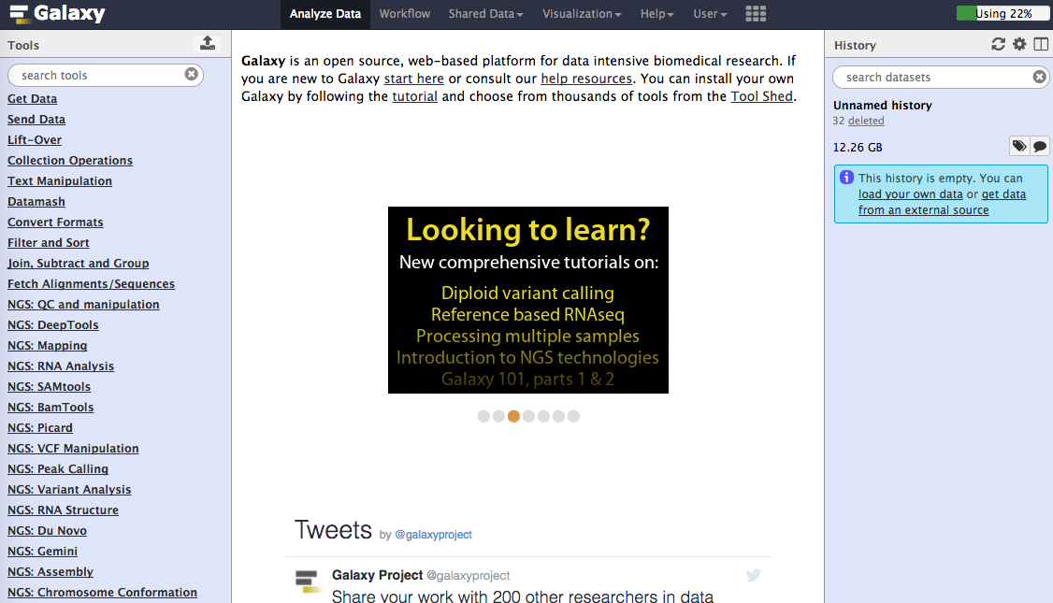
Background
Workflow
Our Approach
Results comparison
Conclusion
Notes:
B

Slide 11
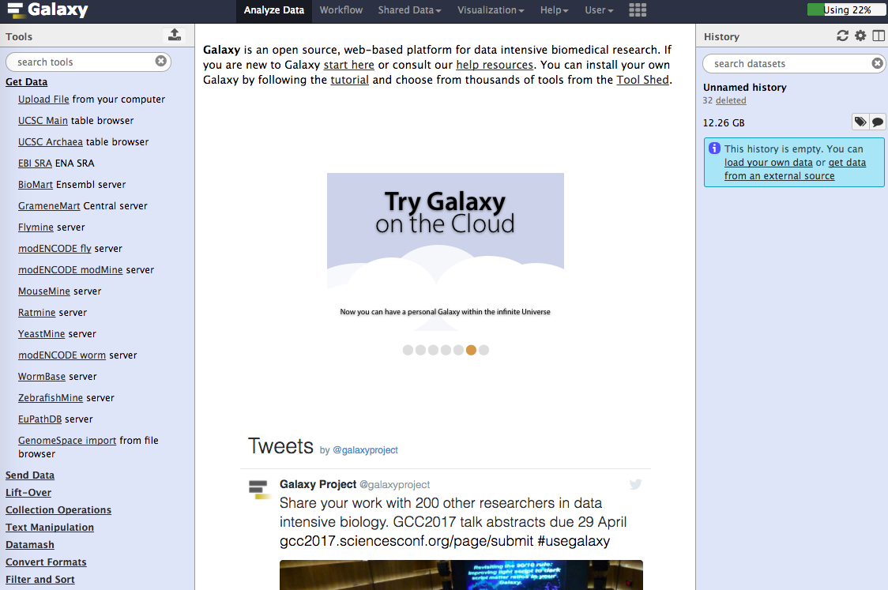
Background
Workflow
Our Approach
Results comparison
Conclusion

Slide 12
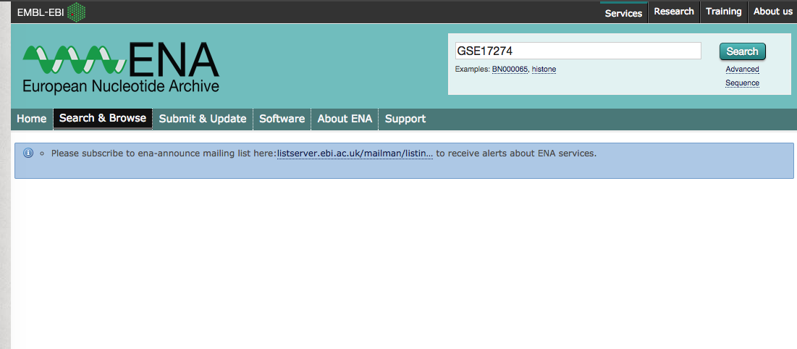
Background
Workflow
Our Approach
Results comparison
Conclusion

Slide 13
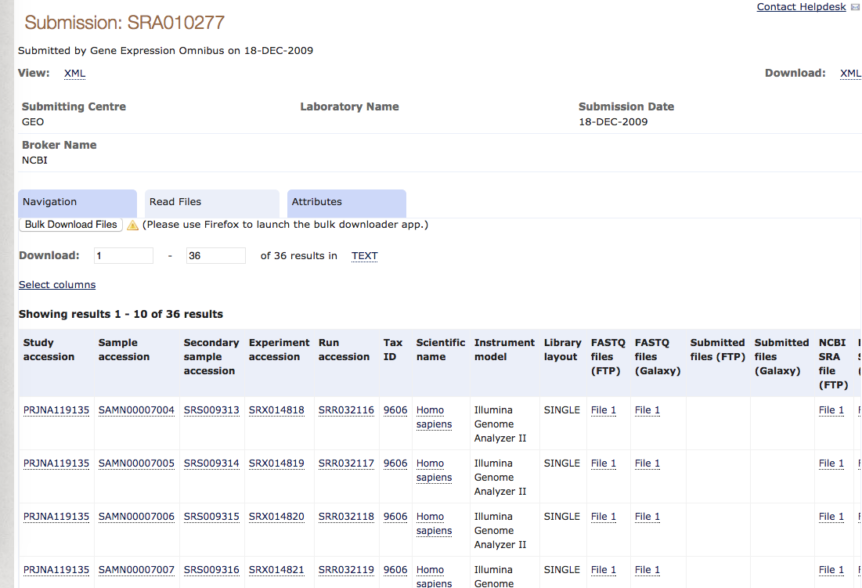
Background
Workflow
Our Approach
Results comparison
Conclusion

Slide 14
OUR APPROACH
Background
Raw reads
Workflow
FASTQC, Trim reads
Galaxy
Quality Control
Our Approach
Convert genomes and read files
fasta2bfa, fastq2bfq
Read mapping
MAQ
Results comparison
Conclusion
Align reads to genomes
match
Read counts
Convert to mapview format
mapview
Notes:
B

Slide 15
OUR APPROACH - Cont’d
Background
Read mapping
Workflow
Our Approach
Definition of orthologous exons
Galaxy “Extract Genomic DNA”
Results comparison
Differential gene expression analysis
edgeR package using R
Read count file with genes in rows and samples in columns
Conclusion
Calculated DE genes using empirical Bayes method
Notes:
B
20689 orthologous genes

Slide 16
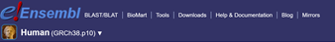
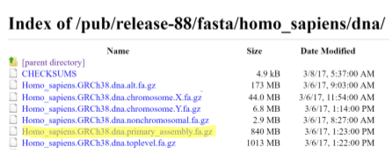
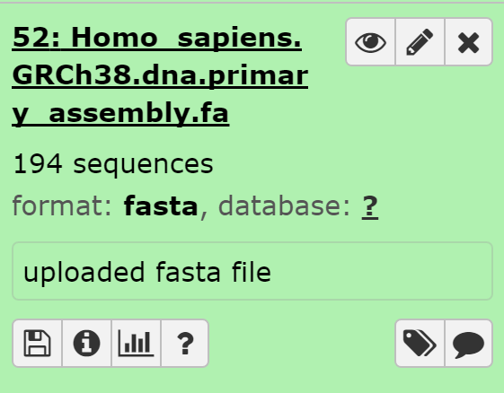
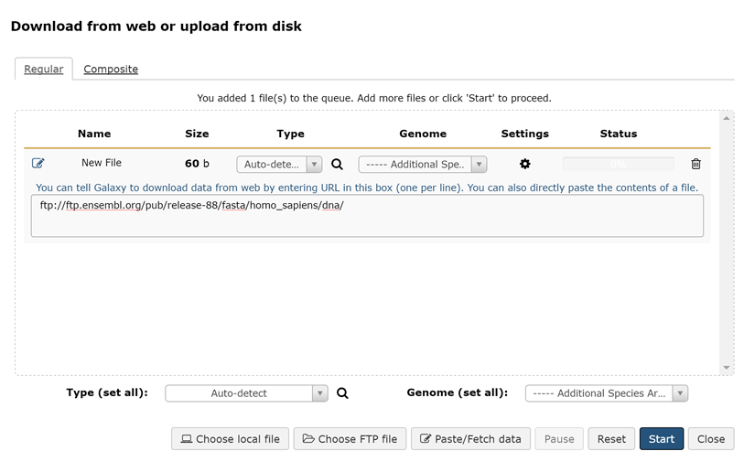
Getting human reference genome release GRCh38
Background
Workflow
Our Approach
Results comparison
Conclusion
Notes:
D

Slide 17

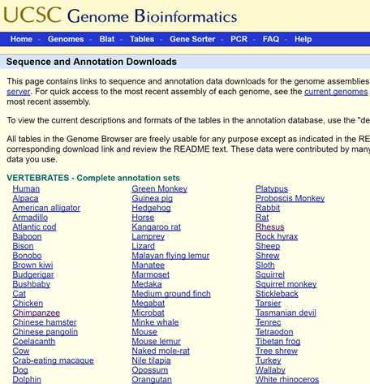
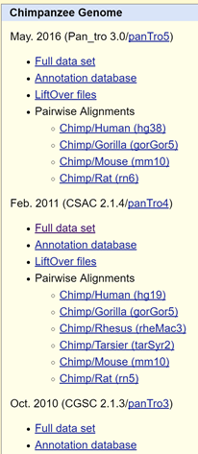
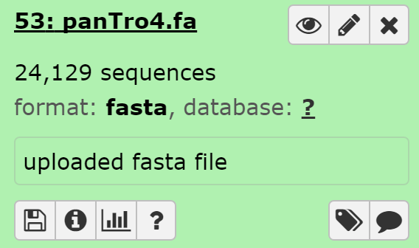
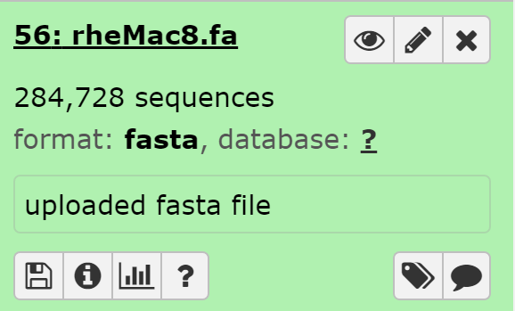
Getting non-human primates, Chimpanzee and Rhesus Monkey reference genomes
Background
Workflow
Chimpanzee
Our Approach
Results comparison
Conclusion
Rhesus Monkey
Notes:
D

Slide 18
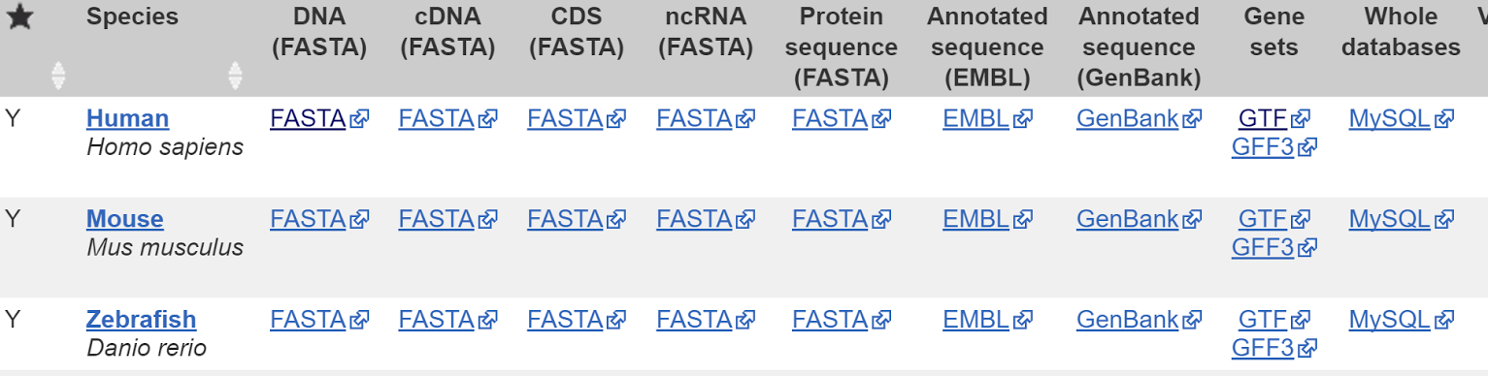
Getting human CDS in GTF format
Background
Workflow
Our Approach
Results comparison
Conclusion
http://useast.ensembl.org/info/data/ftp/index.html
Notes:
D

Slide 19
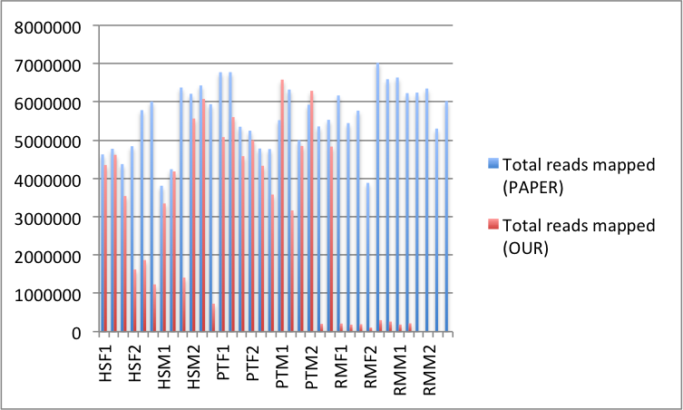
Results comparison - Read mapping
Background
Workflow
Our Approach
Results comparison
Conclusion
Notes:
B
Differences due to: we used different genomes; we are not sure how they did the read count, we did word count

Slide 20
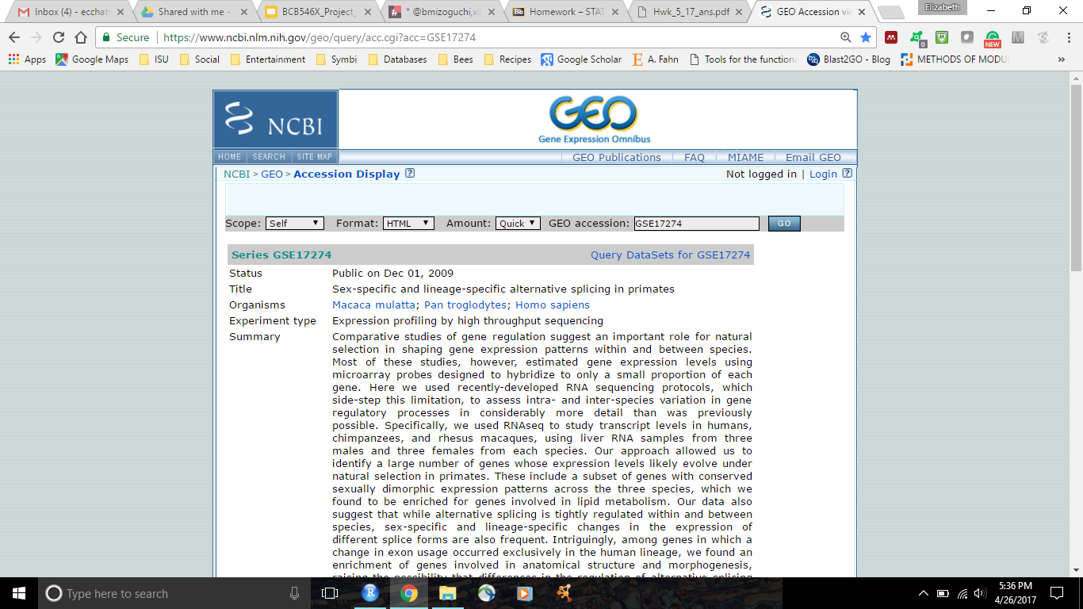
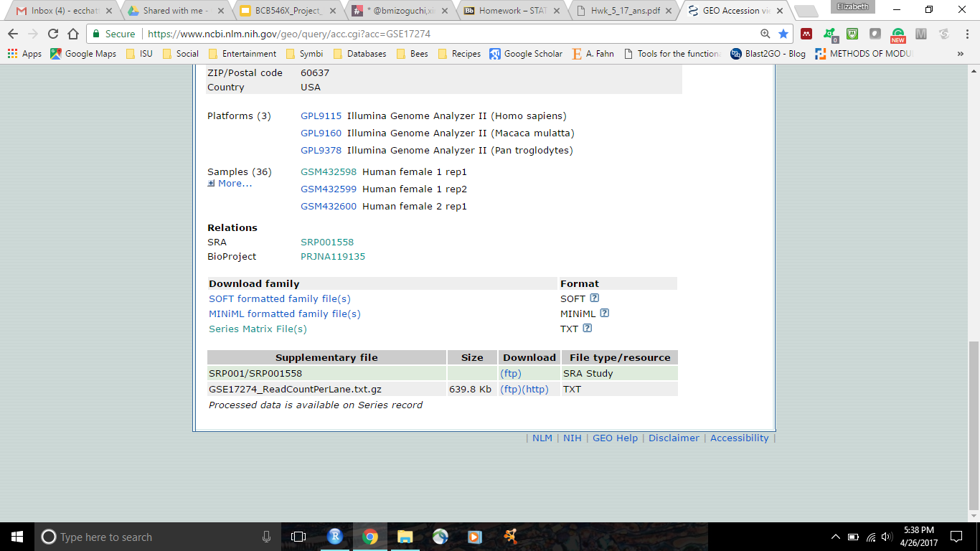
Defining Orthologous Genes for DE Analysis
Authors used BLAT (BLAST-like alignment tool) through Galaxy to identify orthologs shared amongst included species
Removed exons with multiple possible orthologs or highly similar paralogs
Total of 20, 689 orthologous genes
Background
Workflow
Our Approach
Results comparison
Conclusion
Notes:
EC

Slide 21
Statistical Models for DE Analysis
Background
Paper Model:Poisson mixed-effects
Normalized read counts using library size
Likelihood-ratio test statistic using lme4 package in R
Obtain P-values by comparing test statistic to chi-square distribution
Correct for multiple testing and control FDR at 0.05 using Storey and Tibshirani approach
Our Model: Negative binomial
Normalized read counts using Trimmed mean of M values (TMM)
Obtain P-values using exact test from edgeR package in R
Correct for multiple testing and control FDR at 0.05 using Storey and Tibshirani approach
Workflow
Our Approach
Results comparison
Conclusion
Notes:
EC
Author method is less conservative and represents an older less rigorous method for defining DE genes.

Slide 22
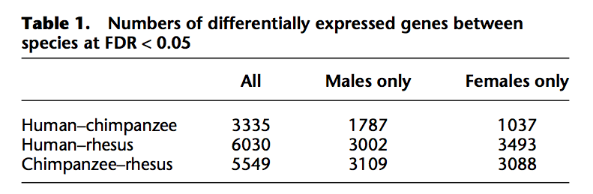
Results Comparison: DE Analysis by Species and Sex
Results in paper
Background
Workflow
Our Approach
Results comparison
Results in our analysis
Conclusion
 | All | Males only | Females only
Human-chimpanzee | 2188 | 1062 | 590
Human-rhesus | 5384 | 2739 | 2506
Chimpanzee-rhesus | 5488 | 3322 | 2364
•More DE genes between human-rhesus than human-chimpanzee for both sexes
Notes:
EC
20689 orthologous genes

Slide 23
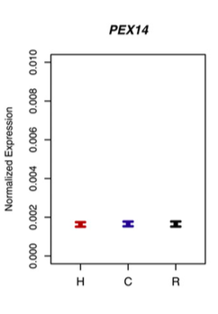
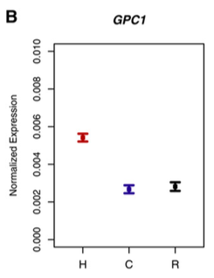
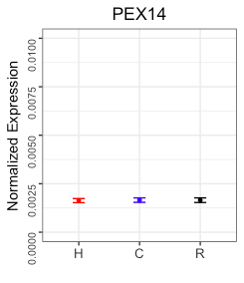
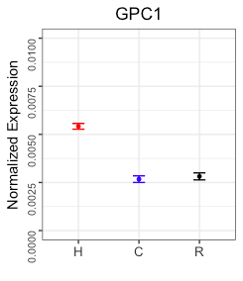
Results Comparison
Figure 1. Genes evolved under stabilizing or directional selection
Background
Workflow
Our Approach
Results comparison
Recreated Figure 1 with the same normalization method in the paper
Conclusion

Slide 24
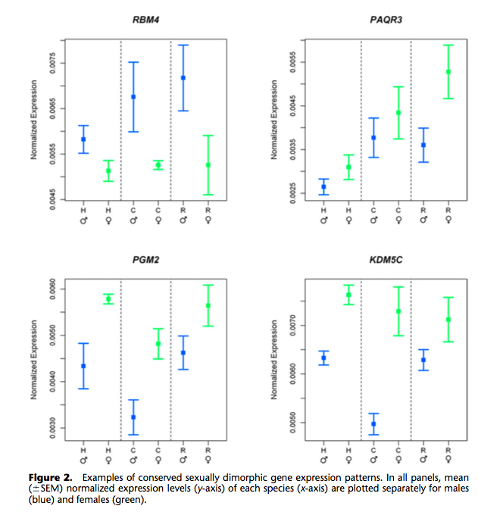
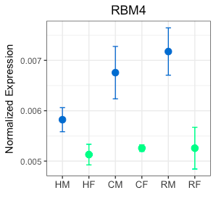
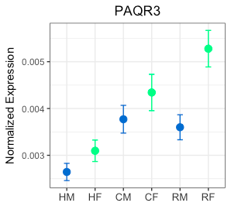
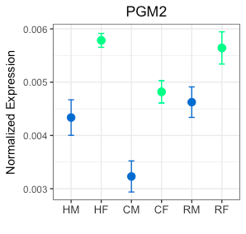
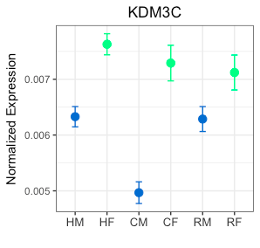
Results Comparison
Figure 2. Genes with conserved sexually dimorphic expression patterns
Background
Workflow
Our Approach
Results comparison
Conclusion
Recreated Figure 2 with the same normalization method in the paper

Slide 25
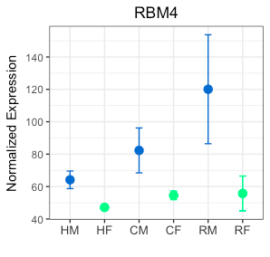
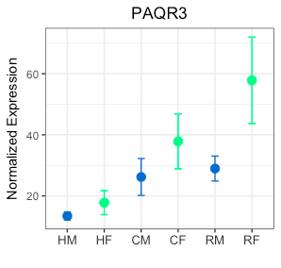
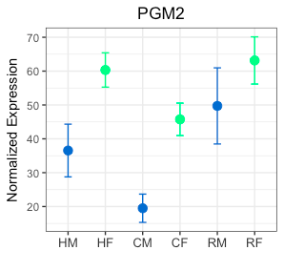
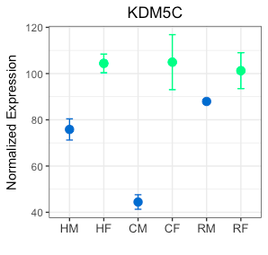
Results Comparison
Figure 2. Genes with conserved sexually dimorphic expression patterns
Background
Workflow
Our Approach
Results comparison
Conclusion
Recreated Figure 2 with Trimmed mean of M values (TMM) normalization

Slide 26
Challenges
Background
Poor documentation:
Authors don’t specify programs or commands used for some steps
Parameters are also not included
Supplementary methods are just a copy of the paper methods with some extra sections
Some statistical methods in the paper are outdated and oversimplified
Workflow
Our Approach
Results comparison
Conclusion

Slide 27
Take Home Messages
Background
Details are never too much
Package versions/Genome release versions
Steps for processing data
Never submit your supplementary data as a word document
Provide clear directions of where to find supplementary materials and which data is available
Workflow
Our Approach
Results comparison
Conclusion
Clear documentation is very important!!!!!
Notes:
EC

Slide 28
THANK YOU

